Slide 1
Theoretical perspectives of Sociology
Ety Rani
Assistant Professor
Sociology discipline
Khulna University

Slide 2
The Functionalist perspective
Functionalism holds that society is a complex system whose various parts work together to produce stability and solidarity. According to this approach, the discipline of Sociology should investigate the relationship of parts of society to each other and to society as a whole.
Functionalist, including Comte and Durkheim, have often used an organic analogy to compare the operation of society to that of a living organism. They argue that the parts of society work together just as the various parts of the human body do, for the benefit of society as a whole. To study a bodily organ like the heart we need to show how it relates to other parts of the body.
By pumping blood around the body, the heart plays a vital role in the continuation of the life of the organism. Similarly, analyzing the function of a social item means showing the part in plays in the continued existence and health of a society.

Slide 3
Functionalism emphasizes the importance of moral consensus, in maintaining order and stability in society. Moral consensus exists when most people in a society share the same values. For instance, Durkheim believed that religion reaffirms people’s adherence to core social values, thereby contributing to the maintenance of social cohesion.
Talcott Parsons and Robert K. Merton, who each drew extensively on Durkheim, were two of its most prominent adherents. Merton’s version of functionalism has been particularly influential. Merton’s distinguished between manifest and latent functions.
Manifest functions are those known to, and intended by, the participants in a specific type of social activity.
Latent functions are consequences of that activity of which participants are unaware.
To illustrate this distinction Merton used the example of a rain dance performed by the Hopi Tribe of Arizona and New Mexico. The Hopi believe that the ceremony will bring the rain they need for their crops (manifest function). This is why they organize and participate in it. But the rain dance, Merton argued, using Durkheim’s theory of religion, also has the effect of promoting the cohesion of the Hopi society (latent function).

Slide 4
Merton also distinguished between functions and dysfunctions. To look for the dysfunctional aspects of social behavior means focusing on features of social life that challenge the existing order of things. For example, it is mistaken to suppose that religion is always functional that is contributes only to social cohesion. When two groups support different religions or even different versions of the same religion, the result can be more social conflicts, causing widespread social disruption. Thus, wars have often been fought between religious communities as can be seen in the struggles between Protestants and Catholics in European history.

Slide 5
Conflict Perspective
The conflict perspective, or conflict theory, derives from the ideas of Karl Marx, who believed society is a dynamic entity constantly undergoing change driven by class conflict. Whereas functionalism understands society as a complex system striving for equilibrium, the conflict perspective views social life as competition. According to the conflict perspective, society is made up of individuals competing for limited resources (e.g., money, leisure, sexual partners, etc.). Competition over scarce resources is at the heart of all social relationships. Competition, rather than consensus, is characteristic of human relationships.
Broader social structures and organizations (e.g., religions, government, etc.) reflect the competition for resources and the inherent inequality competition entails; some people and organizations have more resources (i.e., power and influence), and use those resources to maintain their positions of power in society. C. Wright Mills is known as the founder of modern conflict theory. In his work, he believes social structures are created because of conflict between differing interests.

Slide 6
Conflict Perspective (continue)
People are then impacted by the creation of social structures, and the usual result is a differential of power between the ” elite ” and the “others”. Examples of the “elite” would be government and large corporations. G. William Domhoff believes in a similar philosophy as Mills and has written about the “power elite of America”.
While functionalism emphasizes stability, conflict theory emphasizes change. According to the conflict perspective, society is constantly in conflict over resources, and that conflict drives social change. In the conflict perspective, change comes about through conflict between competing interests, not consensus or adaptation.

Slide 7
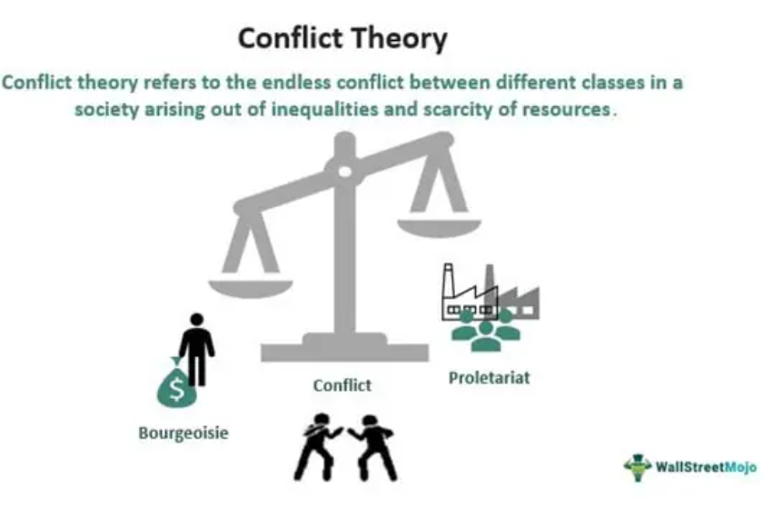
Conflict Perspective (continue)

Slide 8
Conflict Perspective (continue)
However, not all conflict theories take a Marxist approach. Some conflict theorists have also been influenced by Weber. A good example is the contemporary German Sociologists Ralf Dahrendorf. In his now classic work, Class and Class Conflict in Industrial Society , Dahrendorf argues that functionalists thinkers only consider one side of society.
Dahrendorf says, conflict comes mainly from different interests that individuals and groups have. Marx was differences of interest mainly in terms of classes, but Dahrendorf relates them more broadly to authority and power. In all societies there is a division between those who hold authority and those who are largely excluded from it between rulers and ruled.

Slide 9
The Symbolic Interactionist Perspective
Symbolic interaction theory, called symbolic interaction perspective, is a sociology theory that seeks to understand humans' relationship with their society by focusing on the symbols that help us give meaning to the experiences in our life. Social scientists consider symbolic interaction theory as a framework for building theories that see society as a product of everyday human interactions. The symbolic interactionist perspective is based on the notion that people make sense of their social worlds through communication and social interaction - the exchange of meaning through symbols and language. Three major concepts important for understanding this theoretical approach include meaningful symbols, the definition of the situation and the looking glass self. In addition, two important types of theoretical analysis fit within the interactionist perspective: dramaturgical analysis and the labeling approach.

Slide 10
Meaningful Symbols: George H. Mead insisted that the ongoing process of social interaction and the creating, defining and redefining of meaningful symbols make society possible. Meaningful symbols are sounds, objects, colors, and events that represent something other than themselves and are critical for understanding social interaction. Language is one of the most important and powerful meaningful symbols humans have created, because it allows us to communicate through the shared meaning of words.
Definition of the Situation: Definition of the situation refers to the idea that “ If [people] define situations as real , they are real in their consequences” ( Thomas and Thomas, 1928). Simply put, people define social reality through a process of give and take interaction. Once a definition is established, it shapes all further interactions.

Slide 11
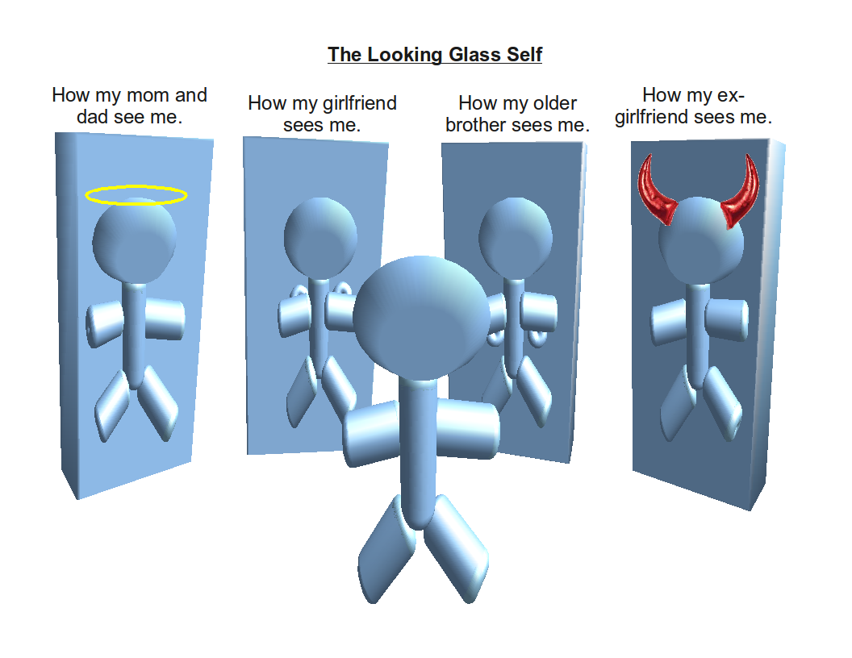
The Looking Glass Self: The looking-glass self, first coined by Charles Cooley, describes how one’s self or social identity is dependent on one’s appearance to others.

Slide 12
Dramaturgical Analysis: A useful theoretical framework within symbolic interactionism, dramaturgical analysis, uses the analogy of the theater to analyze social behavior. In this approach, people are viewed as actors occupying roles as they play out life’s drama. In real life, people take an active part in the drama, manipulating the interaction to present themselves in the most positive light. Thus, people often use impression management to communicate favorable impressions of themselves (Goffman).
The Labeling Approach: Labeling approach indicates that society's assigning of labels to individuals or certain groups can have an effect on their behavior.
Book
1. Thompson and Hickey (Society in Focus: An Introduction To Sociology).
2. Sociology (Anthony Giddens).

